Slide 1
Logical path planning
Róbert Baláž
Technical University of Košice
Faculty of Electrical engineering and informatics

Slide 2
First-order logic
Symbols: A,B,C.
Constants: true, false.
Quantifiers: ∀ = for all, ∃ = at least one.
Sentences can be atomic or more complex, which are composed using logical connectives.
¬(A ∧ B)
Logical connectives: ∧ = and, ∨ = or, → = implies, ↔ = equality, ¬ = negation.
SAT task => solved using DPLL algorithm.

Slide 3
Satisfiability Modulo Theories
Decision problem for logical formulas with respect to combinations of background theories expressed in classical first-order logic with equality.
An SMT instance is a generalization of a Boolean SAT instance in which various sets of variables are replaced by predicates from a variety of underlying theories.
Commonly used theories: theory of real numbers, theory of integers, theory of arrays, theory of arithmetic, theory of difference logic,...
¬(3x + 2y < 5) ∧ (z = 5)

Slide 4
Theory of difference logic
Part of linear arithmetic theory
Predicates must have the following form:
t – s ≤ c,
where t, s are variables and c is constant
Used for scheduling or path planning tasks

Slide 5
Resolving SMT formulas
1.) Translating SMT formulas into first-order logic formulas.
2.) Resolving newly formed SAT formulas with SAT solver(DPLL).
3.) If a model is found, it has to be checked with regards to background theories.
4.) If no model is found by SAT, no model can exist in the field of SMT either.

Slide 6
Path planning – logical approach
Main goal: Express the entire path planning problem in terms of logical formulas.
Expressive power of SAT is insufficient for this task, we require the use of SMT.
Required background theories: theory of real numbers, theory of integers, theory of linear arithmetic, theory of non-linear arithmetic.

Slide 7
Path planning – logical approach
Base resources:
2D line map with known locations of obstacles and environment borders.
Starting location of agent and goal location.
Building formulas:
Path consists of several line segments, each line segment has its starting and ending point.
Every coordinate of every starting and ending point is separate logical variable.
Formulas represent constraints for the path segments‘ coordinates.
Main task:
Navigate agent through the static environment from starting location to goal location without colliding with any obstacle on the way.

Slide 8
Constraints I.
1.) Environment borders
When navigating the robot through the environment, it must never leave the territory inside the map.
In other words, coordinates of the path segments must be neither negative numbers nor higher than respective dimensions of the map.

Slide 9
Constraints II.
2.) Shape of path
Should we choose to build path consisting of only orthogonal segments, we can constraint the segments in a way that only one of the coordinates may change between the starting and ending point of the segment.

Slide 10
Constraints III.
3.) Joining segments
As we‘re trying to build each of the path segments separately, we need to make sure to join every preceding segment with its successor.
In the other words, ending point of every preceding segment must be equal to starting point of every following segment.

Slide 11
Constraints IV.
4.) Start and goal location
We need to connect the start and goal location to the path we‘re building
Starting point of first segment is the start location, ending point of the last segment is the goal location.

Slide 12
Constraints V.
5.) Avoiding obstacles
Most of the obstacles are unique in terms of their shape, which means they can‘t be properly dealt with in general.
Size of the agent needs to be taken account of.
Each obstacle shape requires unique approach.
Typical obstacle shapes: square, rectangle, circle, ellipse, polygon, splines, irregular shapes.

Slide 13
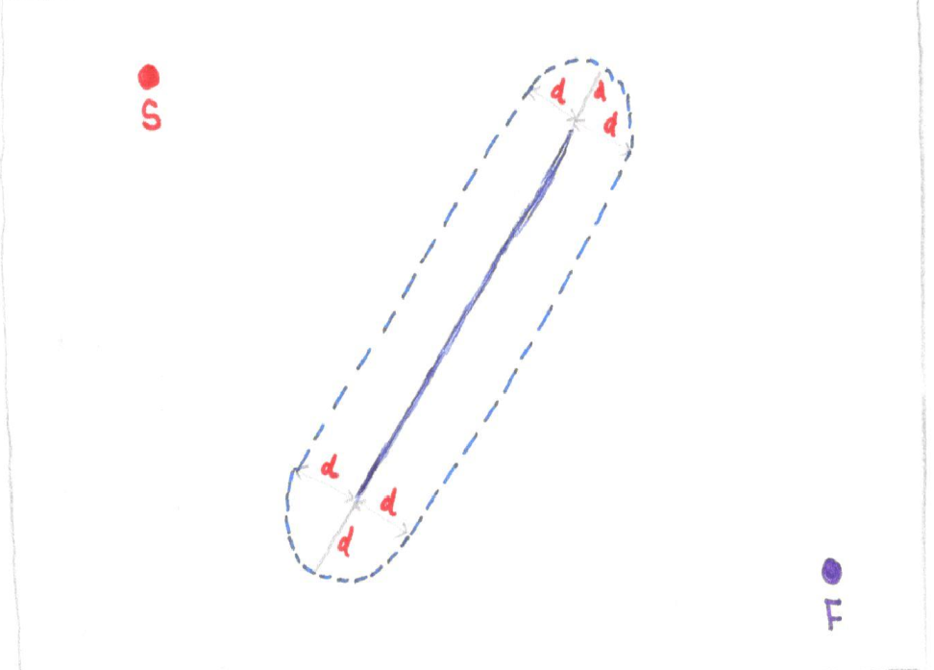
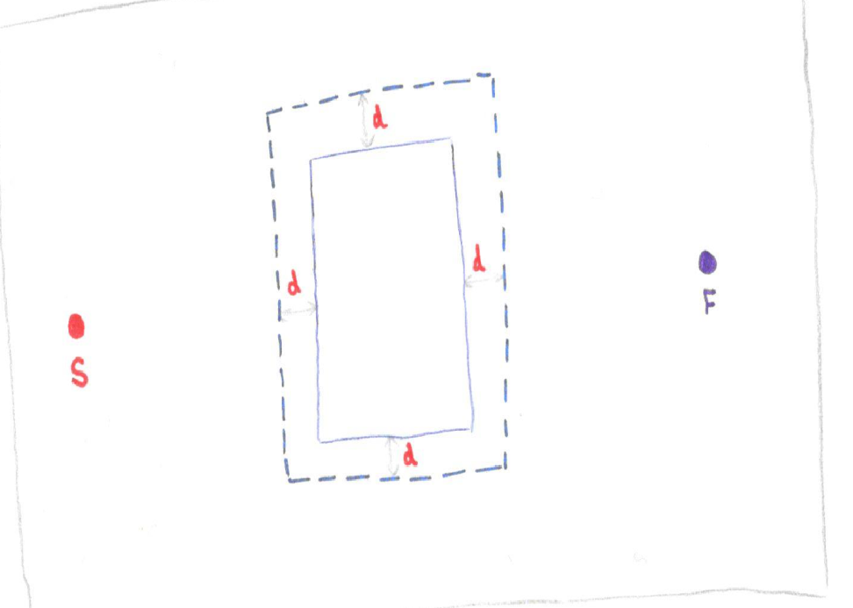
Constraints VI.
Curved lines and shapes containing them
Lines parallel with environment borders

Slide 14
Solving the task - algorithm
Inputs: map, start location, goal location, size of agent.
Output: coordinates of each path node.
Algorithm:
1) n = 1.
2) Try to build path consisting of just n segments.
3) If the attempt fails, increase the number of segments by one and try 2) again.
4) If the attempt is successful, end.
Optimizing:
1) path length.
2) sharp turns.
3) number of path segments.

Slide 15
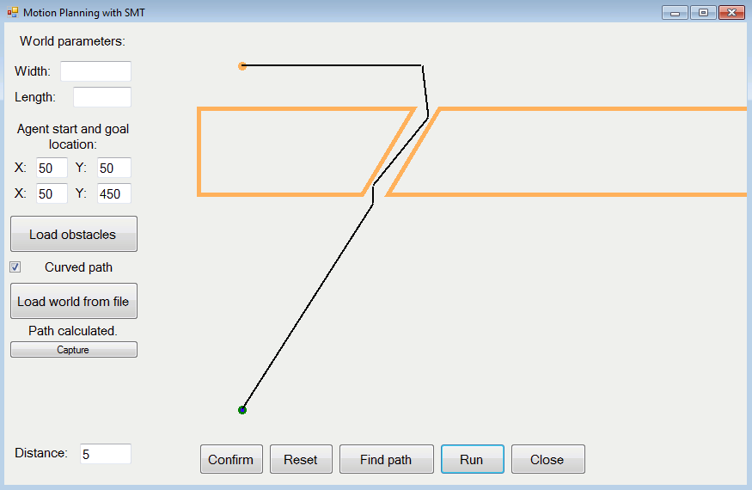
Solution example

Slide 16
Thank you for your attention!

