Slide 1
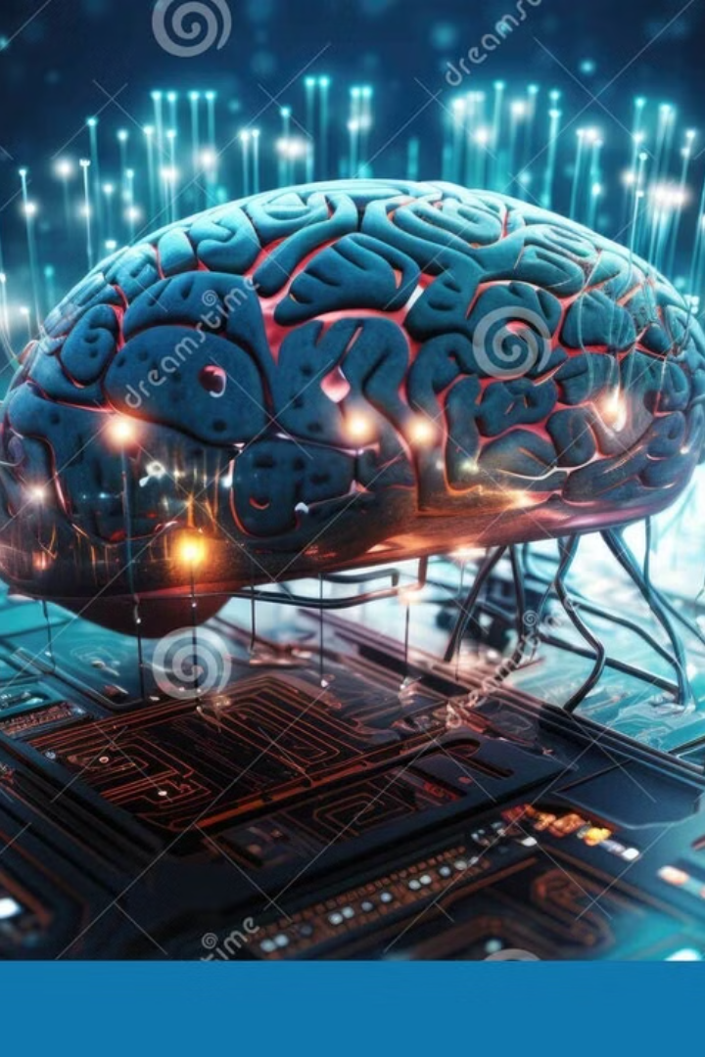
Evolution Through Large Models
Based on OpenAI’s research article by Joel Lehman, Jonathan Gordon, et al., published June 2022.
Presenters:
Yehor Nepokrytyi
Mykhailo Ruzmetov
Paper: https://arxiv.org/abs/2206.08896

Slide 2

Background: Traditional Genetic Programming
The field of genetic programming (GP) applies evolutionary algorithms to evolve computer programs to solve problems. The promise of GP is that computer code is a computationally universal representation that underlies much modern technology, including artificial intelligence itself.

Slide 3

Introduction: A New Frontier in Evolutionary Programming
LLMs Drive Evolution
Traditional Limits
By using LLMs trained on human code edits, the mutation process becomes more informed, targeted, and capable of producing creative solutions that generalize to new domains.
Genetic programming is hampered by randomness in the mutation step.

Slide 4


The Power of LLMs Trained on Code Edits
Large language models trained on version histories of software development—like GitHub commits—have implicitly learned how code evolves over time. These models understand not only syntax, but also intent, style, and context. In the same way a programmer might rename a variable or re-organize a loop, the LLM can propose meaningful modifications to a program. This makes it an ideal candidate to serve as a “mutation engine” in evolutionary programming frameworks.

Slide 5

Replacing Mutation with Prediction
The central innovation is replacing hand-crafted, probabilistic mutation functions with an LLM that predicts likely edits. Instead of flipping random bits, the model is prompted with the current version of a program and asked to propose a modified version. These model-generated edits are then evaluated based on how well the resulting program performs in a given environment. This changes the nature of evolution from blind search to guided exploration.

Slide 6
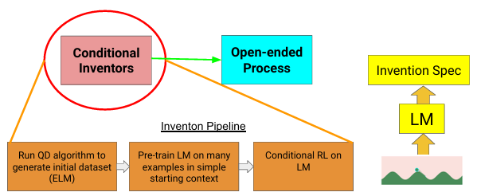
The Invention Pipeline
(left) A three-staged training pipeline bootstraps from a single example of an invention to an LLM that can output an invention tailored to its current condition. The hope for the future is for such a conditional inventor agent to help seed an open-ended process, wherein inter actions between agents and their inventions spur continual innovation. (right) In the Sodarace domain, the conditional inventor observes the terrain, which conditions the LLM to output the speci cation of the desired invention.

Slide 7
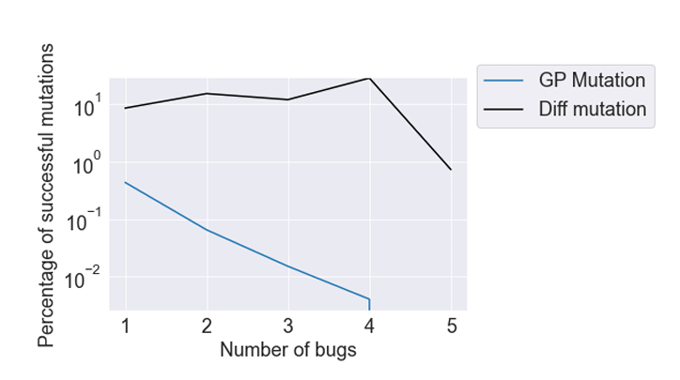
Diff Models – Learning from Code Changes
Diff models are trained on code differences, not static snapshots. This teaches them how code evolves in practice. They propose edits that reflect real developer behavior, producing smart and valid mutations.
Comparing diff mutation to GP mutation in fxing 4-Parity bugs.

Slide 8
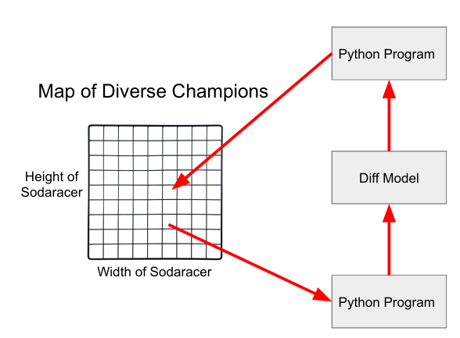
MAP-Elites and Diversity Preservation
In each iteration, an existing Python solution is sampled from the map of solutions for each independent replica of a diff model. Each replica generates a batch of diffs that are applied to the sampled solution to generate modified candidate solutions. These candidates are evaluated and are then inserted into the map if they either establish a new niche or outperform the niches current champion. Over iterations, a single initial seed program gives rise to a diversity of high-performing Python programs.

Slide 9
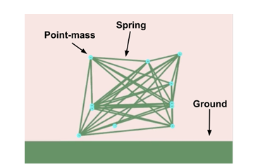
Experiment
The experiment combined the model’s mutations with the MAP-Elites algorithm, which selects for both performance (distance traveled) and behavioral diversity.
Thousands of code edits were generated by the model, creating new creatures that were evaluated in the simulation.
Only a subset of the creatures worked or performed well—but the ones that did helped fill out a rich space of behaviors and designs.
Over time, the LLM’s mutations resulted in programs that outperformed random mutations in both effectiveness and functional validity.

