Slide 1

Towards More Optimal Medical Diagnosing with Evolutionary Algorithms
Deep Technical Analysis of DIAPRO Framework
Authors: Vili Podgorelec, Peter Kokol
Presented by: Abdulrahim Ahmadov, Martina Marasova

Slide 2
Hospital Inefficiency and the Diagnostic Problem
Hospitals inefficient (services, beds, equipment, staff)
Diagnosis process = Key to improve
Goal: Minimize exams, cost, waiting time; Maximize accuracy, sensitivity, specificity

Slide 3
DIAPRO: Diagnostic Process Optimization Framework
Computerized optimization of diagnosis
Tasks: Global optimization, personalization, scheduling, preventive maintenance
Single approach: Evolutionary Algorithms (EA)

Slide 4
Why Evolutionary Algorithms?
Adapt to complex, noisy, multi-objective environments
Handle incomplete data
Find multiple personalized solutions
Enable co-evolution

Slide 5
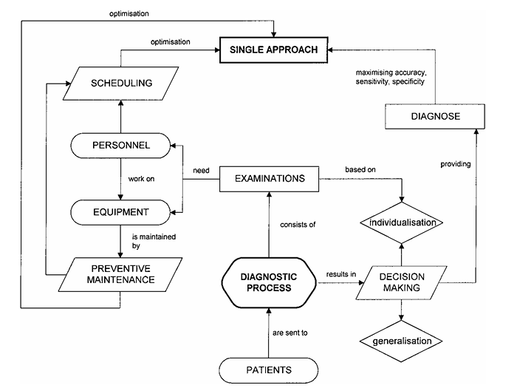
EA Technical Structure in DIAPRO
Individuals: Decision Trees, Scheduling Plans, Maintenance Plans
Population: Evolving set of solutions

Slide 6
Genetic Operators Overview, Decision trees
Selection: Linear Ranking
Crossover: Subtree exchange
Mutation: Change node tests/decisions
EA technique: Multi-Population Model
Crossover: Swaps subtrees between two trees. For example, it picks a random path through each tree and swaps a subtree, creating a new tree that combines parts of both.
Selection: Uses linear ranking selection, where better trees (lower LFF) are more likely to be chosen.
Mutation: Randomly changes parts of a tree , e.g.: Replace a test node with a new test.
Adjust a test’s threshold (e.g., change “heart rate > 100” to “heart rate > 90”).
Swap a decision node for a test node or vice versa.

Slide 7
Construction of Initial Population
Random attribute selection
Random branching
Fulfill leaves with decision classes
Preserves diversity
Trees are randomly generated with a mix of attributes (tests) and decisions. The algorithm ensures diversity by varying tree structure and attribute choices.

Slide 8
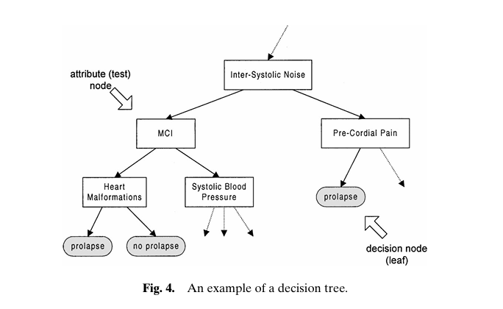
Internal Representation of Decision Trees
Direct encoding into trees
Feasible individuals
Attribute nodes and Decision leaves

Slide 9
Fitness Functions: Local and Global
Local Fitness Function (LFF):
LFF = Σ (wi × (1 - acci)) + Σ (ci × attr(ti)) + (wu × nu)
Penalizes errors, costs, unused leaves
Fitness Function : Measures tree quality based on:
Accuracy for each diagnosis class (e.g., correctly identifying prolapse).
Cost of tests (some tests are more expensive or risky).
Number of unused nodes (nodes no objects reach, which are wasteful).
w_i: Weight for each class’s accuracy. acc_i: Accuracy for class i. c_i: Cost of test at node t_i. nu: Number of unused nodes. Goal: Minimize LFF (lower is better).
The best tree from the main population competes with the others based on a global fitness function

Slide 10
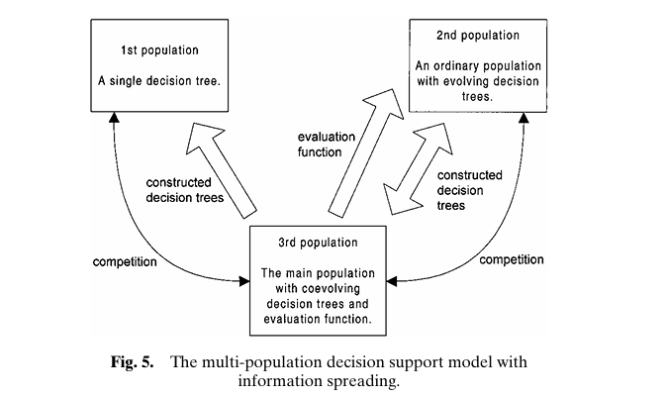
Multi-Population Evolution and Self-Adaptation
Main evolving pop. vs C4.5 trees
Self-adapting fitness weights
The model uses three populations: Main Population: A single decision tree, initially built using the traditional C4.5 algorithm (a standard, non-evolutionary method for decision trees). This acts as a baseline or “general solution.”
Population 1: A group of decision trees evolving using the EA (with selection, crossover, mutation).
Population 2: Another group of evolving decision trees, similar to Population 1 but independent.
If the main tree dominates, it “spreads” its knowledge by adjusting weights in the other populations’ fitness functions, encouraging them to improve.

Slide 11
Preventive Maintenance Program Optimization
Co-evolution of time and personnel plans
Goals: Minimize downtime, Maximize availability

Slide 12
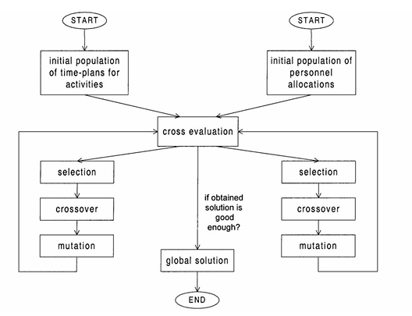
Cross-Evaluation and Co-evolution Preventive Maintenance Program (PMP) Optimization
Purpose: Schedule equipment maintenance to maximize reliability while minimizing downtime.
Problem: Maintenance tasks (e.g., checking an ECG machine) need a time-plan and personnel assignment.
Constraints: Some tasks must happen before others, only trained workers can do certain tasks, and personnel are limited.
Goal: Minimize maintenance time and personnel use.
Co-Evolution: Both populations evolve simultaneously but independently .
A cross-evaluation function combines one time-plan and one personnel allocation to score the global solution
Example: A time-plan might schedule Task A at 9 AM, and the personnel allocation assigns two workers. The cross-evaluation checks if this is feasible and efficient.
How EAs Work: Two Populations (Page 15, Fig. 6):
Time-plans: Orders of maintenance tasks, considering dependencies (e.g., Task A before Task B).
Personnel allocations: Assignments of workers to tasks, respecting constraints (e.g., trained workers only).
Fitness Function: Measures: Total maintenance time.
Number of personnel used.
Constraint violations (e.g., untrained workers).

Slide 13
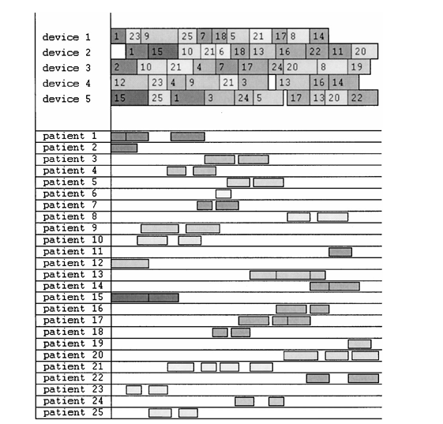
Scheduling of Examinations
Purpose: Create efficient schedules for patient tests, minimizing waiting times and maximizing equipment use.
EA Technique: Genetic Algorithm with Learning
How EAs Work: Population: Each individual is a schedule (a plan assigning patients to machines and times).
Initial Population: Random feasible schedules are generated (Page 13).
Fitness Function: Evaluates schedules based on:
Total duration of all tests.
Patient waiting times between tests.
Machine idle times.
Goal: Minimize these factors.

Slide 14
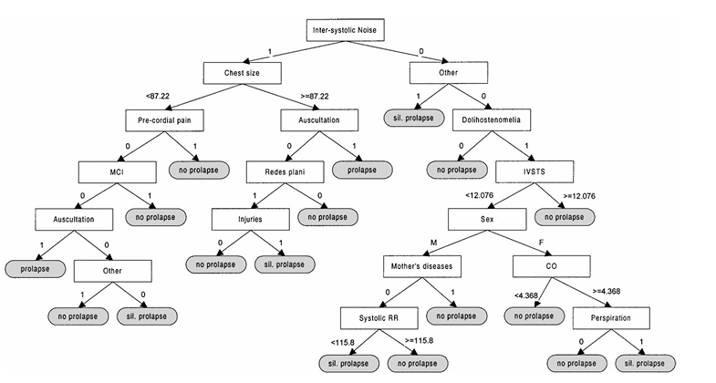
Case Study: Mitral Valve Prolapse Diagnosis
Dataset: 631 patients, 103 parameters
Accuracy: 78.8% → 93.9%
Sensitivity: 63.6% → 81.8%
Specificity: 90% → 95%

Slide 15

Thank you for your attention!

Slide 16
Link
Towards More Optimal Medical Diagnosing with Evolutionary Algorithms | Journal of Medical Systems

